Slide 1


CHURN PREDICTION

Slide 2

What is the problem
Finding current employees who are most likely to quit, using the information of employees who have left the job before

Slide 3
About Data
HR Data of a Company
14.999 Samples
10 attributes in detail as:
satisfaction_level: It is employee satisfaction point, which ranges from 0-1.
last_evaluation: It is evaluated performance by the employer, which also ranges from 0-1.
number_projects: How many of projects assigned to an employee?
average_monthly_hours: How many hours in average an employee worked in a month?
time_spent_company: time_spent_company means employee experience. The number of years spent by an employee in the company.
work_accident: Whether an employee has had a work accident or not.
promotion_last_5years: Whether an employee has had a promotion in the last 5 years or not.
Departments: Employee's working department/division.
Salary: Salary level of the employee such as low, medium and high.
left: Whether the employee has left the company or not.

Slide 4
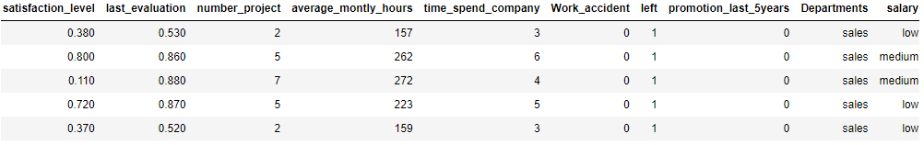
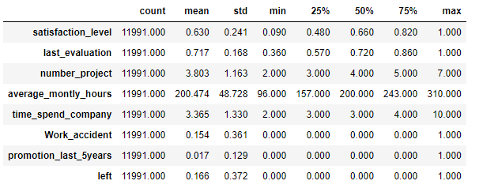
First Look at Data
Our data is clean in terms of "null" values and contains 3.008 "duplicated" data. We are clearing these lines from our data.

Slide 5
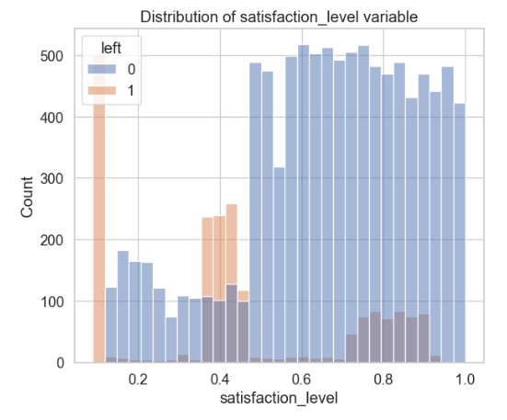
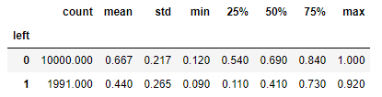
Data Insights
When the "Satisfaction Level" is analyzed for the employees who left and did not leave, it is seen that the customers who left are generally far from the average satisfaction level. However, there is also a part that leaves even though he states that he is satisfied. This may be due to outside job offers, health problems or sudden events.

Slide 6
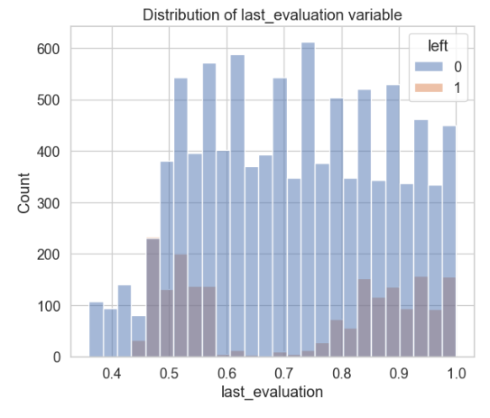
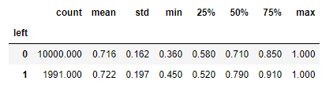
Data Insights
When the "Last Evaluation" values of the employees are examined, it is seen that the employees with the lowest score continue, and almost half of those who left have a good evaluation. This shows us that half of those who left have unilateral dissatisfaction.

Slide 7
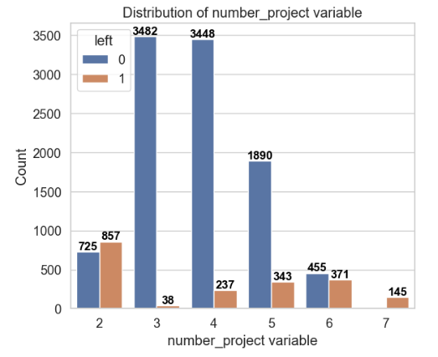
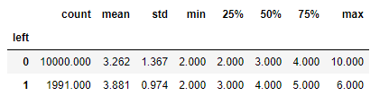
Data Insights
Considering the number of projects that the employees are assigned to, it is seen that a significant portion of those who left are assigned to 2 projects. However, it is clear that those assigned to more projects in the proportional distribution have a higher dropout rate.

Slide 8
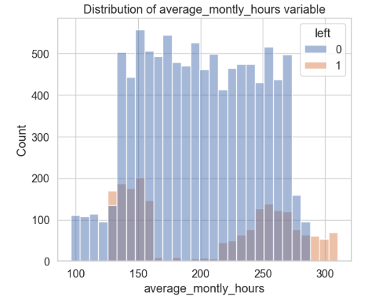
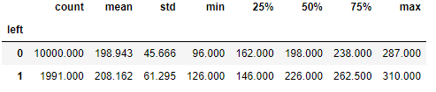
Data Insights
Looking at the monthly working hours, it is seen that the employees with the highest number of hours quit their job. When we look at all those who quit, it is obvious that working hard cannot be a general reason for leaving. But we can say that it is an important factor for a small business group.

Slide 9
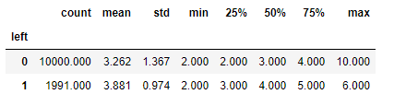
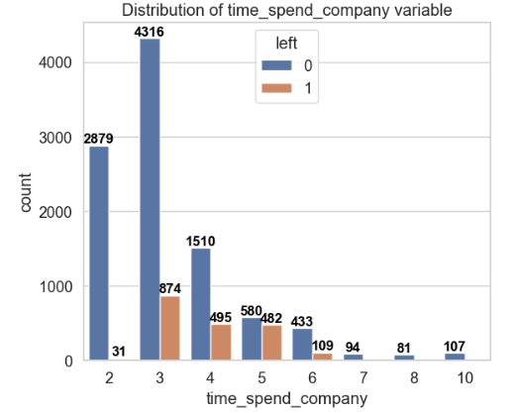
Data Insights
Considering the number of years employees have been at the workplace, it is seen that those who quit their jobs generally have a 3-6 year background. There is a serious concentration in 5-year-old employees.

Slide 10
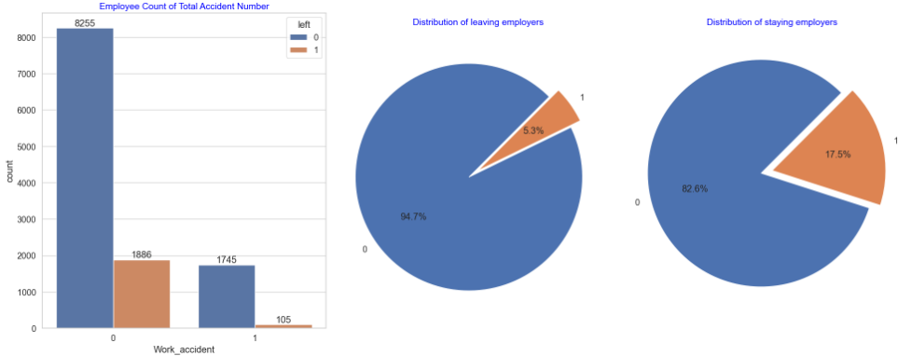
Data Insights
When the occupational accidents of the employees are examined, it does not seem that there is no effect of the occupational accidents for the customers who leave. The department you work here can also have an effect.

Slide 11
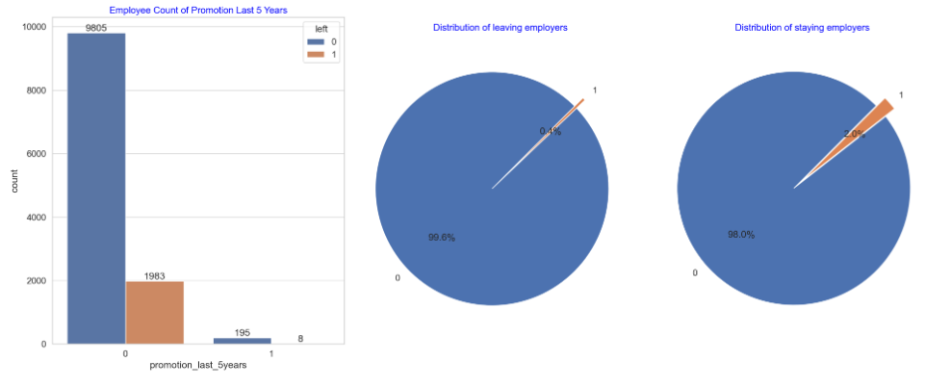
Data Insights
It will not make sense to use this data as very few employees have been promoted in the last 5 years.

Slide 12
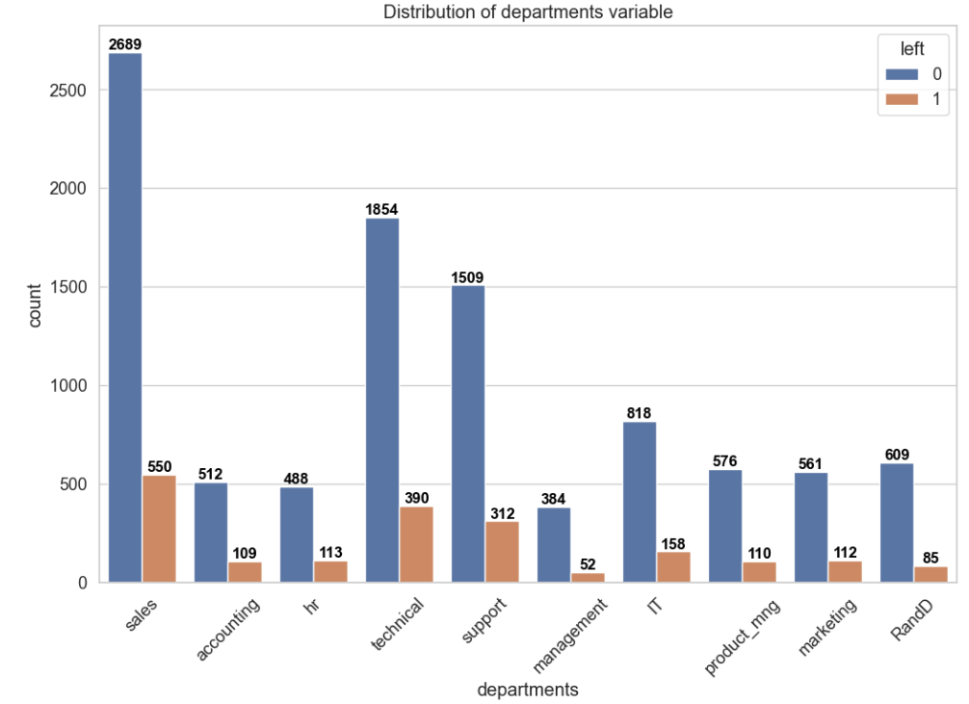
Data Insights
When we examine those who left the job on a departmental basis, there is no striking situation in most departments at first glance. But for some departments, this information can turn into meaningful data.

Slide 13
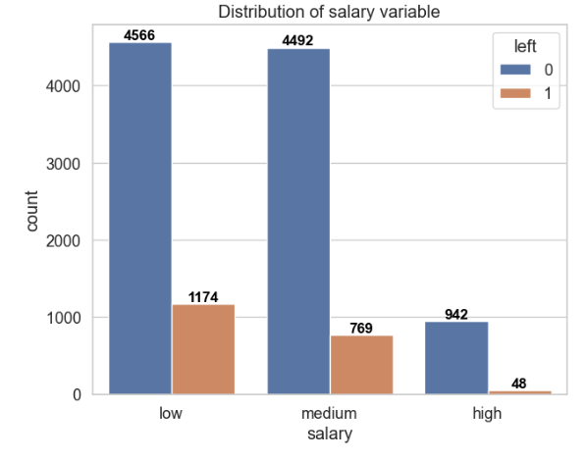
Data Insights
When the effect of salary level is analyzed, it is seen that as the salary level increases, the turnover rate decreases significantly.

Slide 14
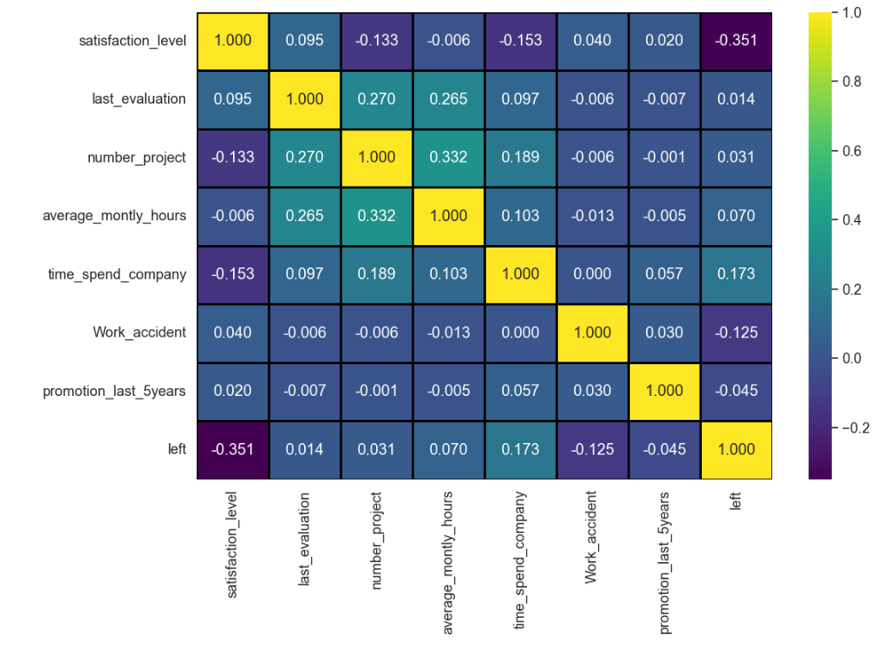
Data Insights
When the correlations between features are examined, excessive correlation values are not observed.

Slide 15
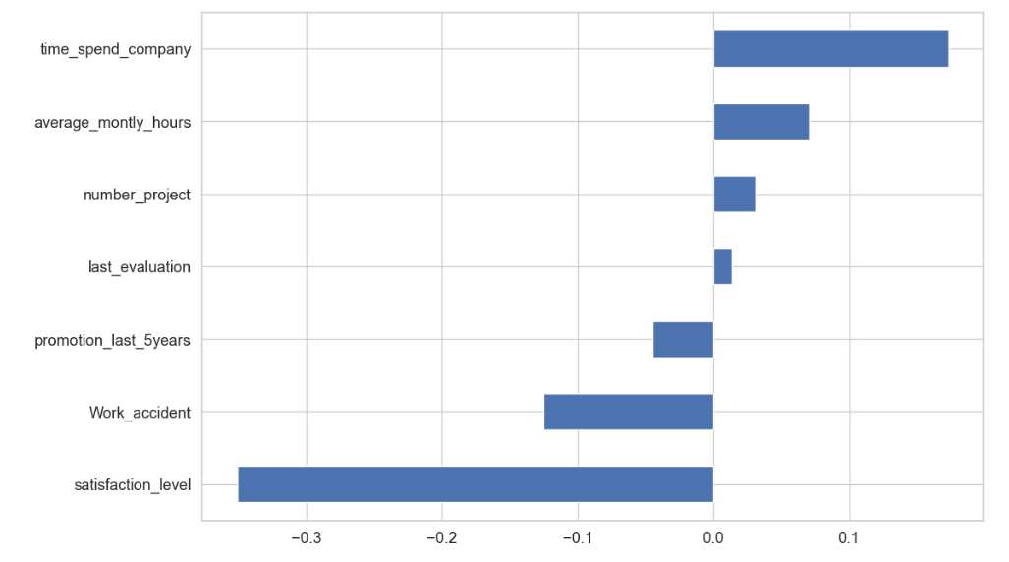
Data Insights
When we examine the highest correlations related to leaving the job, it is seen that the total working year and monthly total working hours have a positive correlation, and the occupational accidents and satisfaction level have a negative correlation. However, since these values are small, we can say that the most direct effect stems from the level of satisfaction.

Slide 16
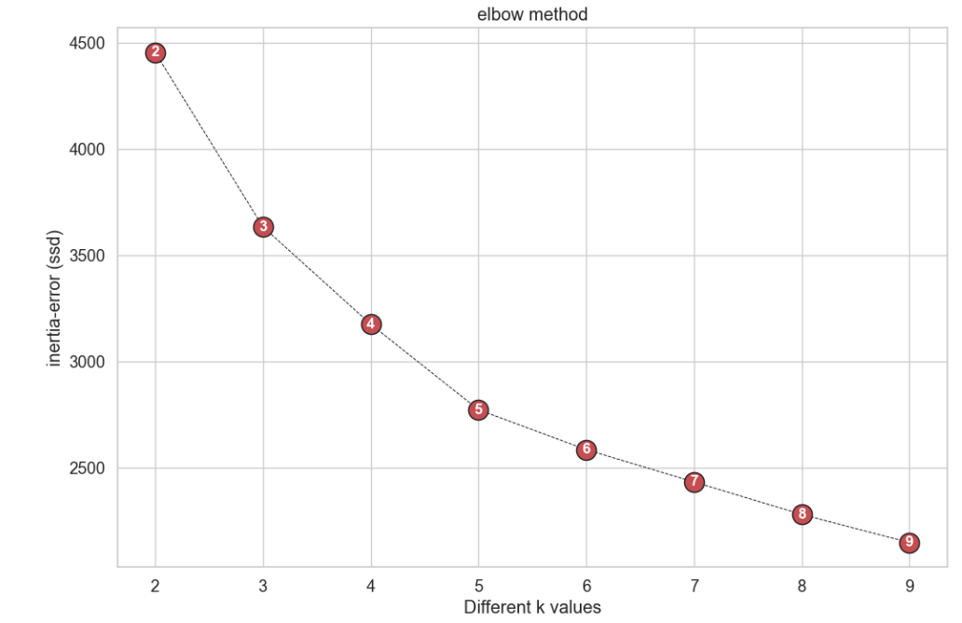
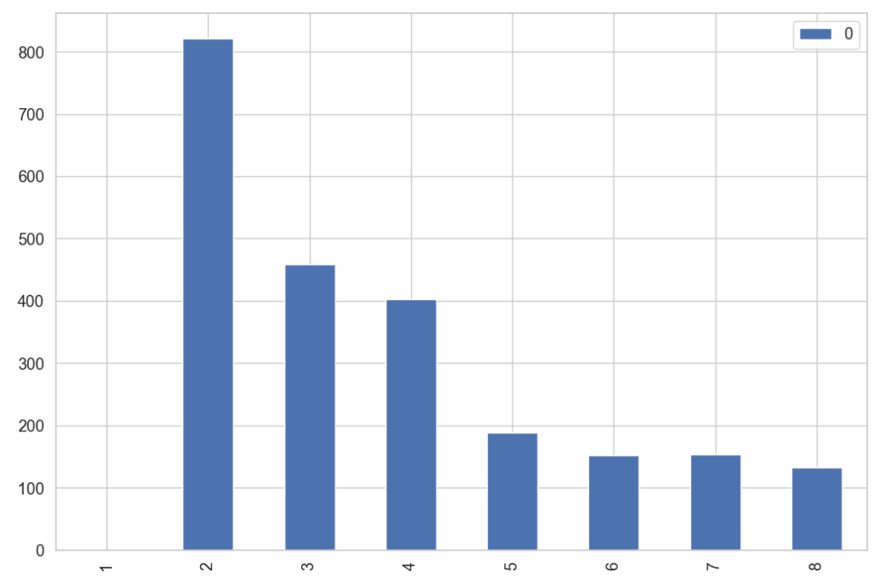
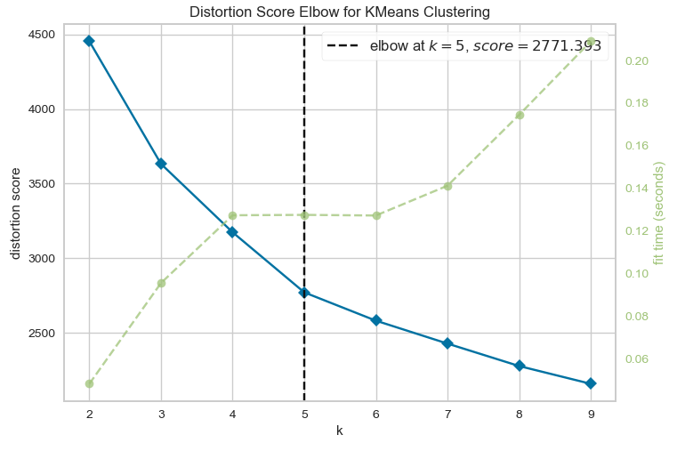
Cluster Analysis of with K-Means
We will use K-Means analysis to see the clusters that our data can create within itself. We will then see if the resulting clusters shed any light on Churn values in a meaningful way.Elbow, which we used to determine the optimum number of classes for K-Means Cluster analysis, recommends us 5 classes.

Slide 17
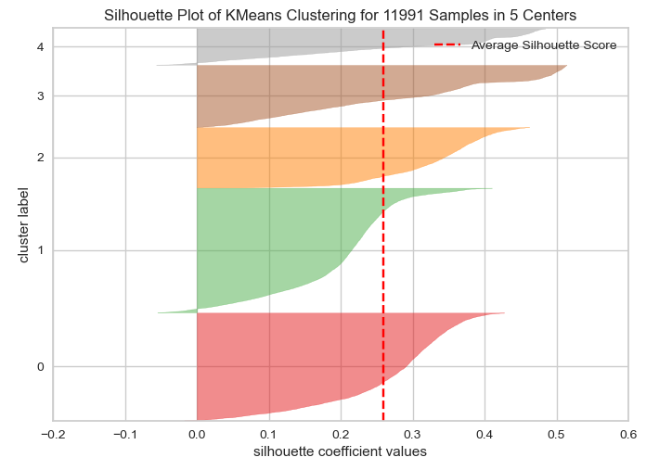
Cluster Analysis of with K-Means
Looking at the Silhouette table, which shows how well the data in the separated clusters fit into their respective classes, it is seen that the classes are well segregated*.
*(The success of good separation is related to the small number of negative values, close to 1 of the positive values)

Slide 18
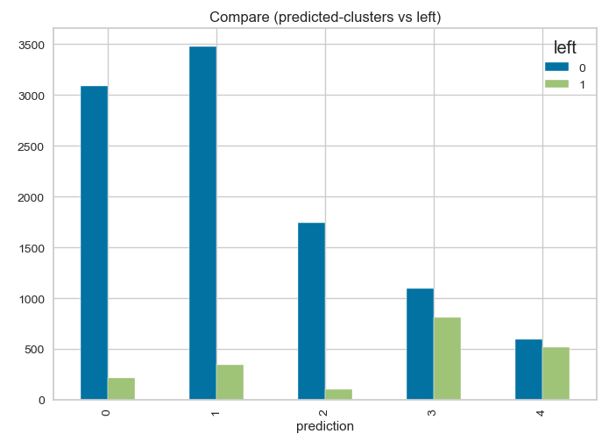
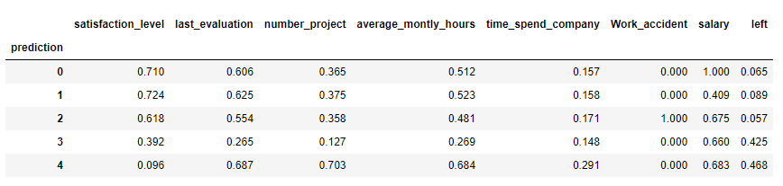
Cluster Analysis of with K-Means
The model offered us 5 classes and we saw that these classes were separated in a meaningful way, but we cannot say exactly how much it covers the employees allocated to these classes. Roughly speaking, we can say that classes 0-1-2 did not quit, while 3 and 4 did. We should not forget that in this classification, clustering is done without taking any results as a basis. We will try to get better results in the next stages.

Slide 19
KNN (K-Nearest Neighbours)
Split data as Train and Test
Test Size %20
Model Building
Salary ['low', 'medium', 'high’] → 0, 1, 2 (OrdinalEncoder)
Departments [‘sales’, ‘IT’, ‘hr’ ……] → New features (‘sales’ 0-1, ‘IT’ 0-1….)
Scaler
Min Max Scaler (More usefull than Standard Scaler when the upper and lower boundaries are well known from domain knowledge)

Slide 20
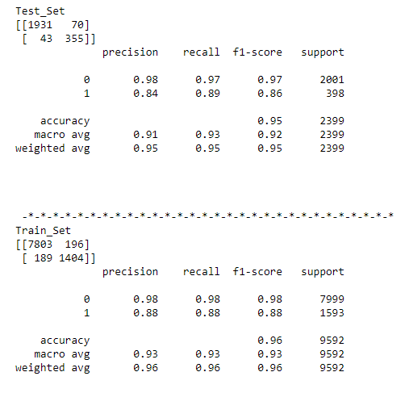
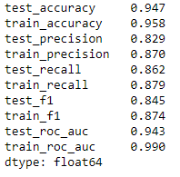
KNN (K-Nearest Neighbours)
When we examine our results, we see that our Test and Train scores are close to each other. This shows us that the model is consistent. but to be more sure we will use Cross validation.
CV results also support the values we found. We'll do a Grid Search next to find the best coefficients.

Slide 21
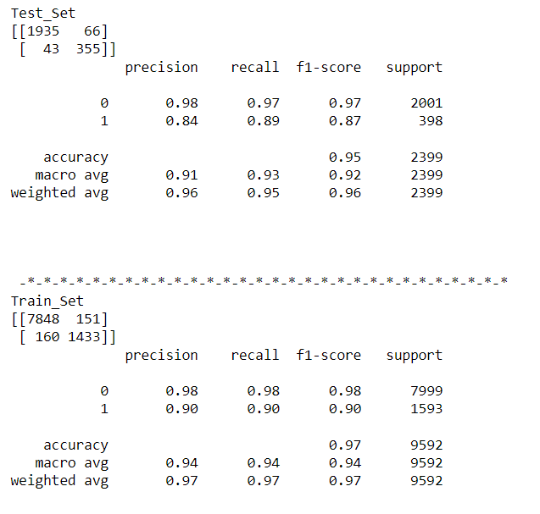
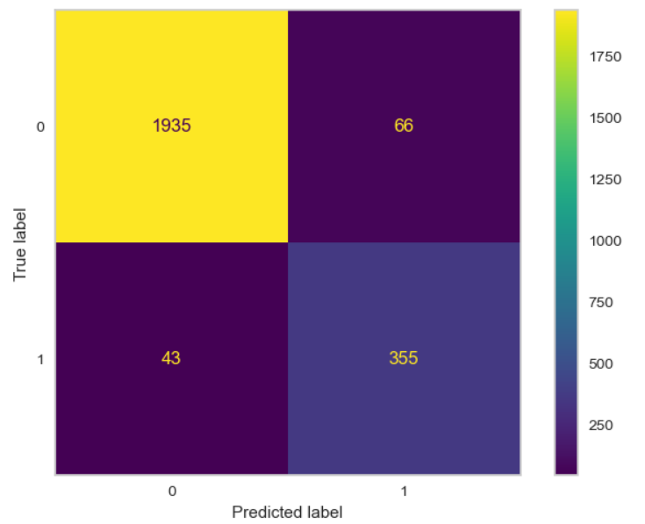
KNN (K-Nearest Neighbours)
We finalized our model as follows with the fine-tuning we did with Grid Search. Whether we can find better results than these will become clear as we try the next models.

Slide 22
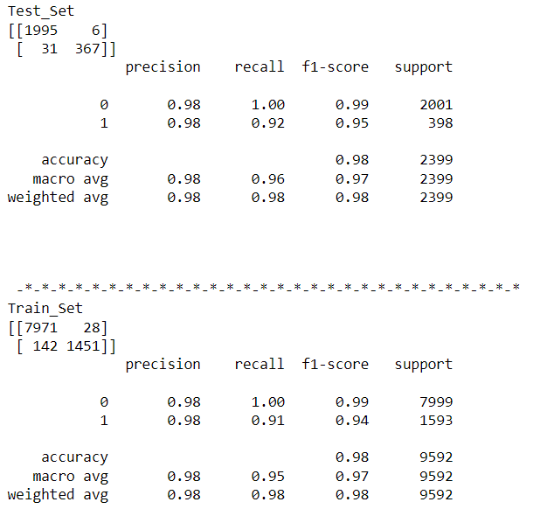
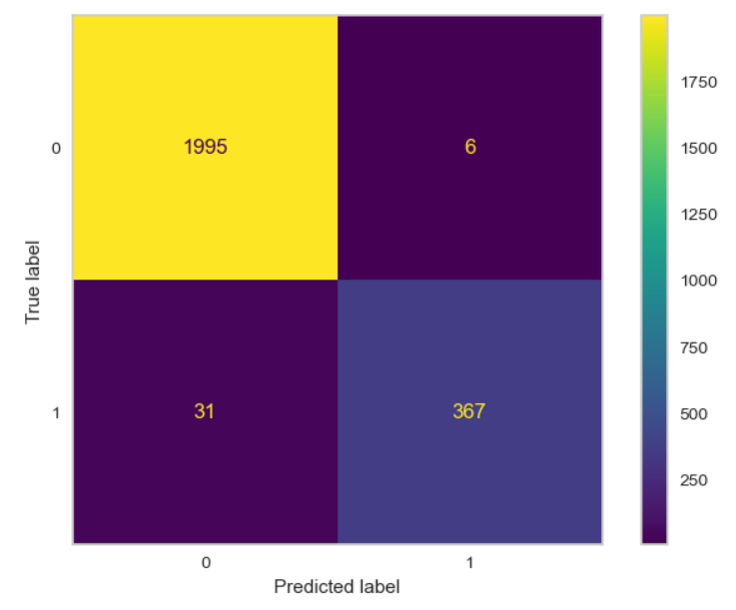
Random Forest Classifier
When we examine our results, we see that we got better results than KNN.

Slide 23
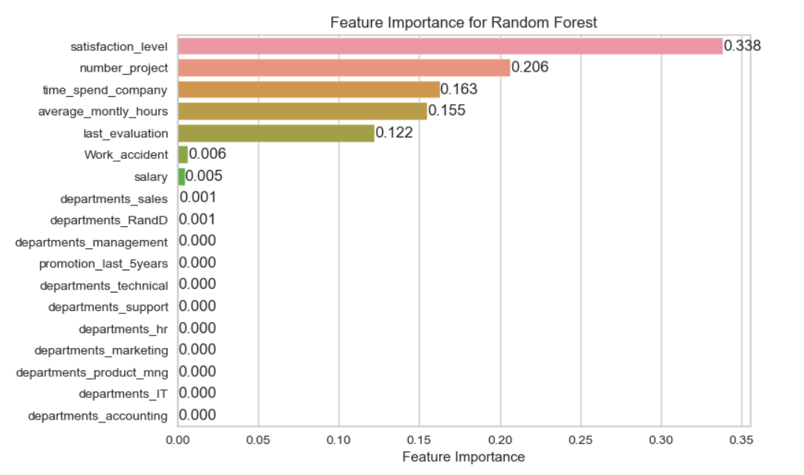
Random Forest Classifier
When Feature Importances are examined in Random Forest analysis, "Satisfaction Level" and "Number Project" stand out as coefficient values. However, we can say that the departments of the employees are not important.

Slide 24
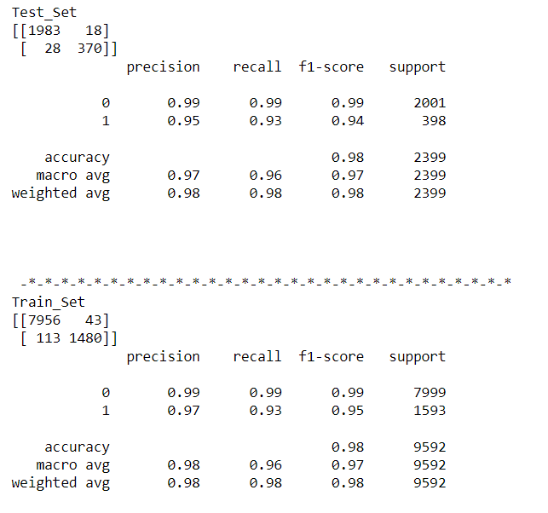
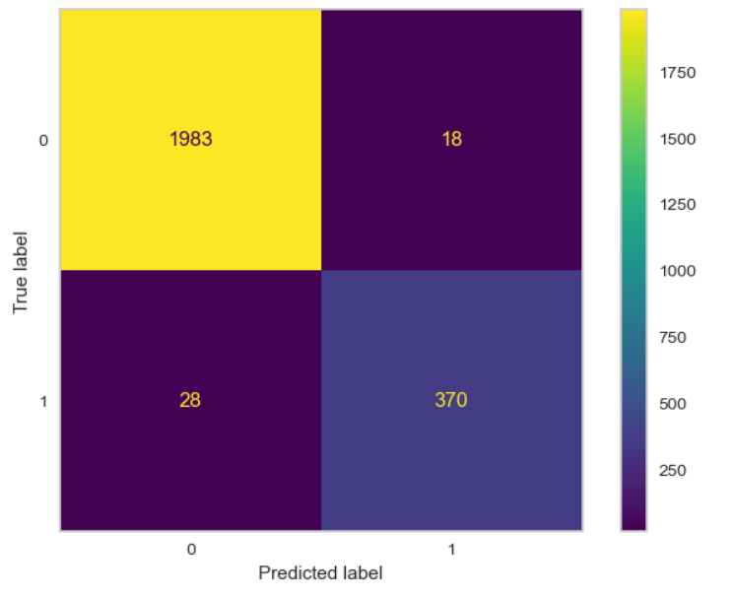
XGBoost Classifier
When the values of XGBoost are examined, it is seen that Random Forest is not caught in the overfitting values. He also found the Churn values slightly better. For this reason, we can say that it is superior to Random Forest.

Slide 25
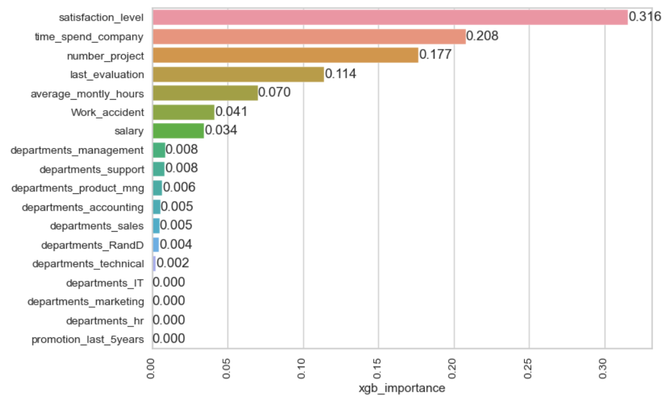
XGBoost Classifier
When the Feature Importances found by XGBoost are examined, we see that unlike Random Forest, the employees also attach importance to their departments. In addition, the order of importance of other features also differs.

Slide 26
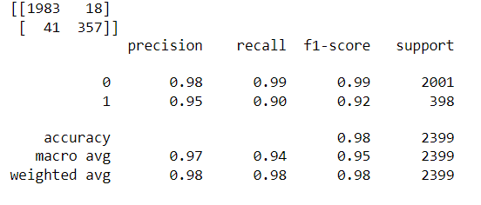
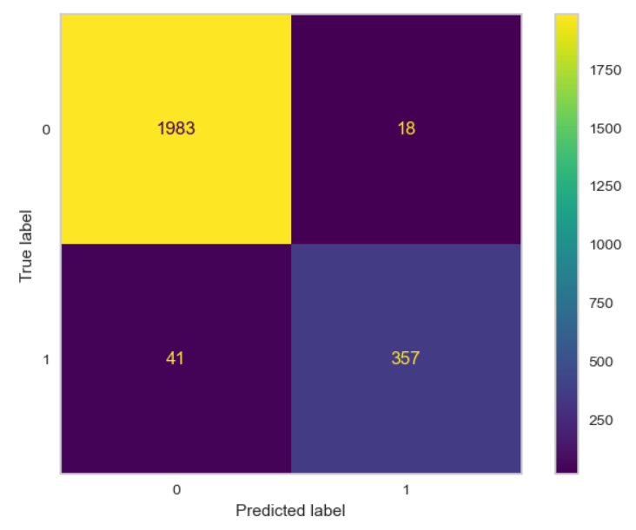
ANN Classifier
The ANN Classifier is more complex than the other analyzes we've reviewed before. In this analysis, we used weighting in the data because the number of employees who quit was less than those who did not. We also made use of "Early Stop" to reduce transaction cost and prevent overfitting.
When we examine the results, we can say that it is a little behind XGBoost.

Slide 27
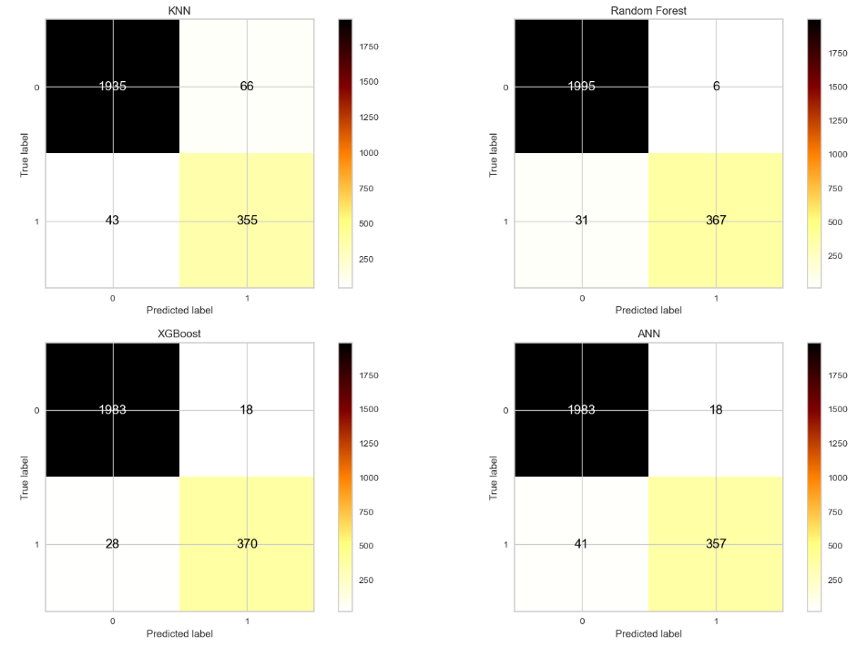
Model Comparison
When all the results are examined, we will base on the Recall values, taking into account the business knowledge. For this reason, we will use the XGBoost model, which gives us the best Recall value.

